Slide 1
Building Blocks for Educators
an overview of our educational materials and resources

Slide 2
For Educators
Organized by series
Current series:
Finance
Human Body
Animals and Plants
Physical Science
Coming soon:
Math: Foundations
Computer Science
Math: Moving Beyond Foundations
Geography
Chemistry

Slide 3
Mini Sites
Each series has its own mini site that contains
A brief overview
Standards Alignment
Reading Resources
Classroom Activities
Differentiated Lesson Plans

Slide 4
Standards Alignment
Building Blocks books are aligned to nationally recognized standards:
Common Core State Standards
Next Generation Science Standards
National Standards for Personal Financial Education
CDC National Health Education Standards
And more!

Slide 5
What Are Standards?
Standards are foundational in education:
Clear set of developmentally appropriate goals
Mainly address conceptual understanding to be achieved by the end the year
Vertically aligned so what students learn one year connects to what they are to learn the next year
Standards affect all stakeholders:
Road map and planning tool for teachers
Shared with students as objectives
Evaluated by administrators
Considered by curriculum directors and other district-level positions
Basis of many standardized tests

Slide 6
Standards Alignment
Standards are organized by grade level or grade band (e.g., middle school)
The dropdown menu allows for easy viewing
Educators can see how each standard aligns with the individual books in a series
Can be a great tool for unit or other planning

Slide 7
Reading Resources
Every book in the series comes with a discussion guide and a comprehension check
Both use a variety of question types, hit multiple levels of Bloom’s Taxonomy, and encourage deep thinking about the content
Both are downloadable as Word Documents and can be modified by educators as needed

Slide 8
Reading Resources: Discussion Guides
Include 10 questions and possible answers
Can be used during or after reading
Highlight related page ranges to support finding textual evidence
Address main ideas covered by the entire text

Slide 9
Reading Resources: Comprehension Checks
Include 10 questions in a ready-to-print format
Contain an answer key
Can be used for assessment
Use a variety of question types
Matching
Fill in the blank
Open-ended
Address main ideas covered by the entire text

Slide 10
Classroom Activities
Aligned to standards and include objectives
Allow educators to bring some fun, engagement, and reflection to students’ learning
Contain easy-to-follow procedures
Include downloadable materials
Often as Word documents or Power Point presentations so they can be edited and modified
Are a great option for guest or substitute teachers

Slide 11
Differentiated Lesson Plans
Aligned to standards and include objectives
Designed for a variety of ages and abilities
Address requisite prior knowledge needs, vocabulary, and assessment options
Include downloadable materials
Often as Word documents or Power Point presentations so they can be edited and modified
Provide differentiation considerations to support students’ diverse learning needs

Slide 12
Differentiated Lesson Plans
Typically follow the Gradual Release of Responsibility to ensure students have multiple opportunities to engage with content
Includes step-by-step procedures for educators:
Introduction and hook
Direct instruction and modeling
Application activity
Independent application and demonstration of learning
Closure

Slide 13
Differentiated Lesson Plans
Many differentiation strategies have been shown to benefit almost all learners regardless of need, therefore they have been directly embedded into our lesson plans
Some strategies we frequently use include:
Student choice
Strategic grouping for collaboration
Leveled assignments and texts
Movement

Slide 14
Differentiated Lesson Plans
Because all educators have unique learning needs to address, other differentiation considerations have been included.
These are suggestions as one of our fundamental beliefs is that educators know their students best and deserve the opportunity to choose the materials, tasks, supports, and extensions they believe to be beneficial.
Educators are encouraged to modify lesson plans to best support their students.

Slide 15
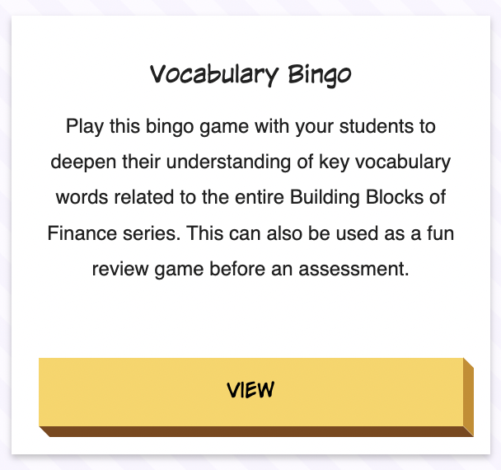
Building Blocks of Finance Highlights
Overview
Classroom Activity
National Standards for Personal Financial Education
7 sets of Reading Resources
Classroom Activities:
Vocabulary Bingo
Debit Cards vs. Credit Cards
My Spending Priorities
Differentiated Lesson Plans:
Supply and Demand
Savings and Important Opinion Writing

Slide 16
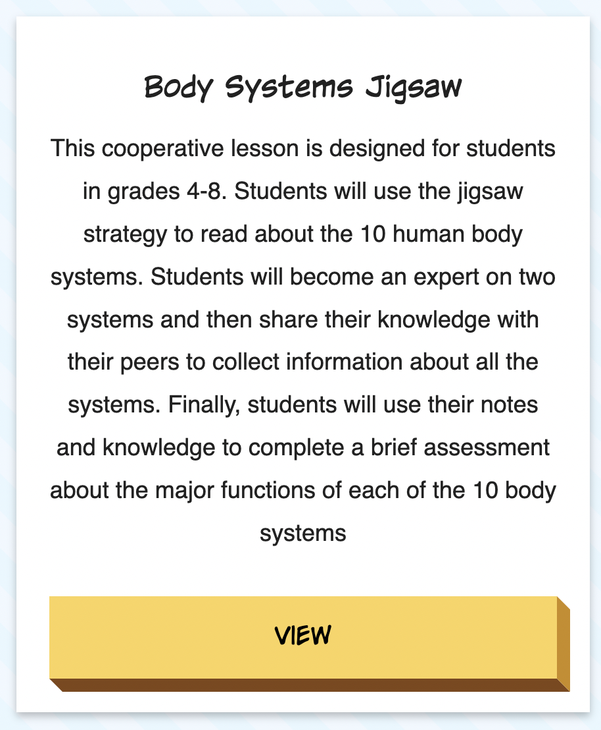
Building Blocks of the Human Body Highlights
Overview
Differentiated Lesson Plans
Next Generation Science Standards, CDC National Health Education Standards, Shape America National Sex Education Standards
8 sets of Reading Resources
Classroom Activities:
Cells, Tissues, and Organs, Oh My!
Follow the Digestive System
Breathe In, Breathe Out
Differentiated Lesson Plans:
Body Systems Jigsaw
A Heart-y Investigation

Slide 17
Building Blocks of Animals and Plants Highlights
Overview
Differentiated Lesson Plan
Next Generation Science Standards
8 sets of Reading Resources
Classroom Activities:
Frayer Model Vocabulary
Cell Organelles
Metamorphosis: Sequence the Stages
Differentiated Lesson Plans:
Natural Selection and Adaptations
The Naked Egg Experiment
Bean Seed Germination Experiment

Slide 18
Building Blocks of Physical Science Highlights
Overview
Classroom Activity
Next Generation Science Standards
10 sets of Reading Resources
Classroom Activities:
Two Ways to Change
Not Just in Lightbulbs
The Truth About Magnets
Differentiated Lesson Plans:
Simple Machines Jigsaw
The Truth of the Matter
Force and Motion in the Real World

Slide 19
Coming Soon: More Building Blocks!
Math: Foundations
Computer Science
Math: Moving Beyond Foundations
Chemistry
Geography

Slide 20
Building Blocks of Math: Foundations Highlights
Overview
Classroom Activity
Common Core State Standards for Mathematical Practice and Common Core State Mathematics Standards
6 sets of Reading Resources
Classroom Activities:
Addition Strategy Spotlight
Subtraction Strategy Spotlight
Multiplication Strategy Spotlight
Division Strategy Spotlight
Differentiated Lesson Plans:
Introduction to Equivalent Fractions
Operation Round Up
INSERT IMAGE of Multiplication Strategy Spotlight when updated on site

